Slide 1

Covid-19 Vaccine Tweets Analysis
Team AYG
Notes:
Hi Everyone, we are team AYG and we are here to present our analysis on the covid-19 vaccine tweets.

Slide 2

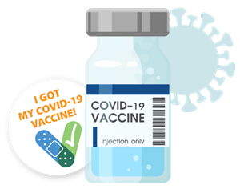
Table of Contents
01
02
03
Background & Objective
Tweets Overall Analysis
Vaccine Brand Analysis
04
04
Sentiment Prediction
Recommendations
Notes:
We are going to first introduce our motives and objectives on covid-19 tweets analysis. We will give an overall text analysis on covid 19 tweets and then will dive deeper into vaccine brand analysis. We also conducted machine learning models to predict users sentiment on the covid 19 vaccination. Lastly, we will provide our recommendations to the public based on our analysis.

Slide 3
01
Background & Objective

Slide 4
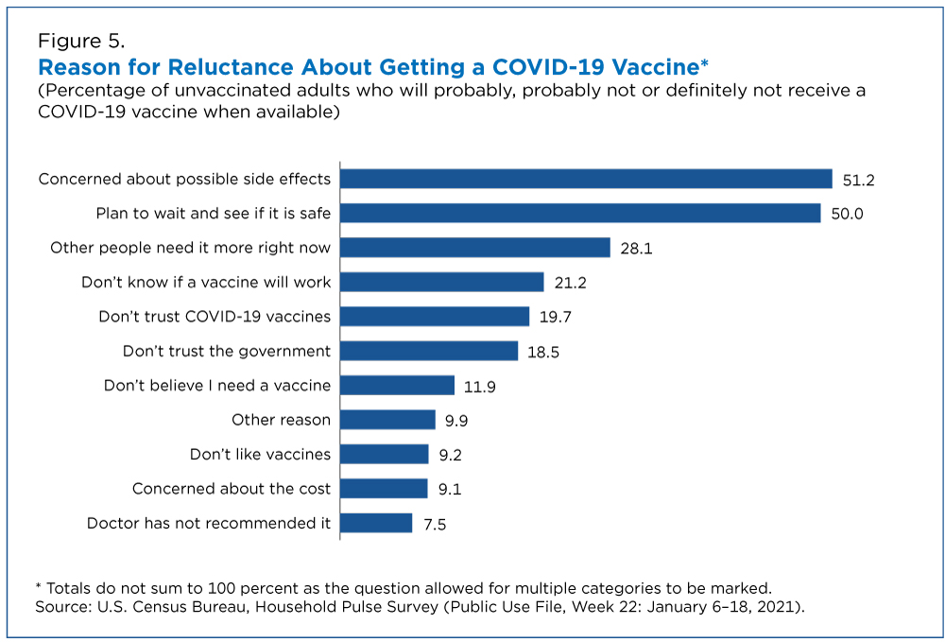
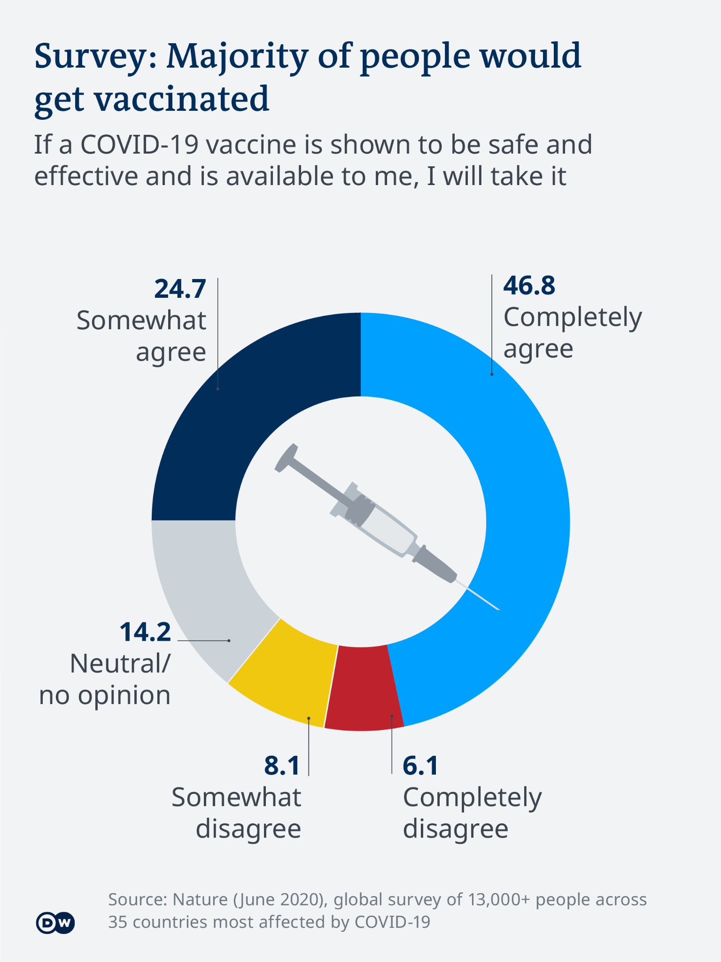
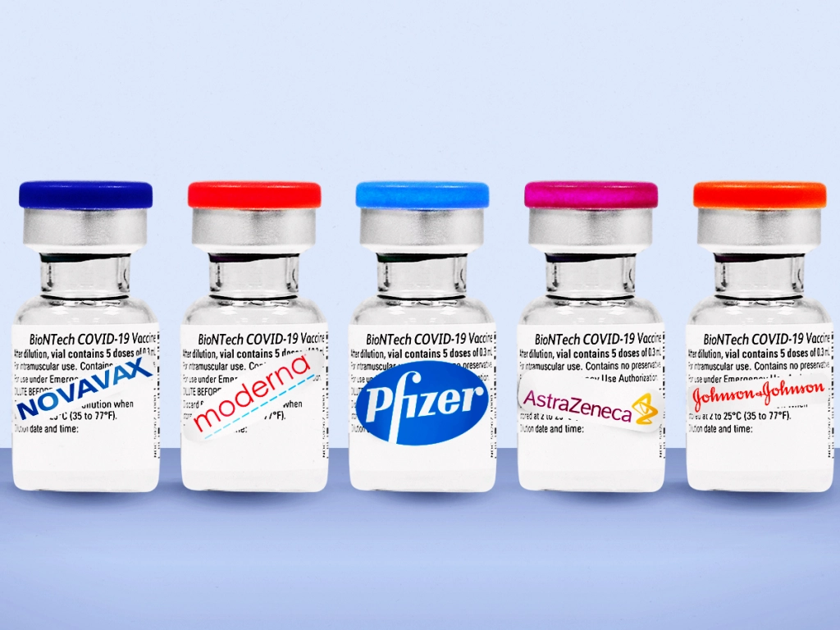
Background
Notes:
With the recent rollout and deployment of the COVID-19 vaccines, many of us are wondering what the general consensus or opinion of the vaccine is. As this seems to be a widely debated and questionable topic in all news outlets and social media. In order to understand the general public reaction, we decide to use twitter’s data as the main data source. As one of the most popularest platform, Twitter played a crucial role in the health care industry and became the public preferred social media communication tool. With its virtually real time data, Twitter offers an opportunity for earlier insights into the public’s reaction to the pandemic.

Slide 5

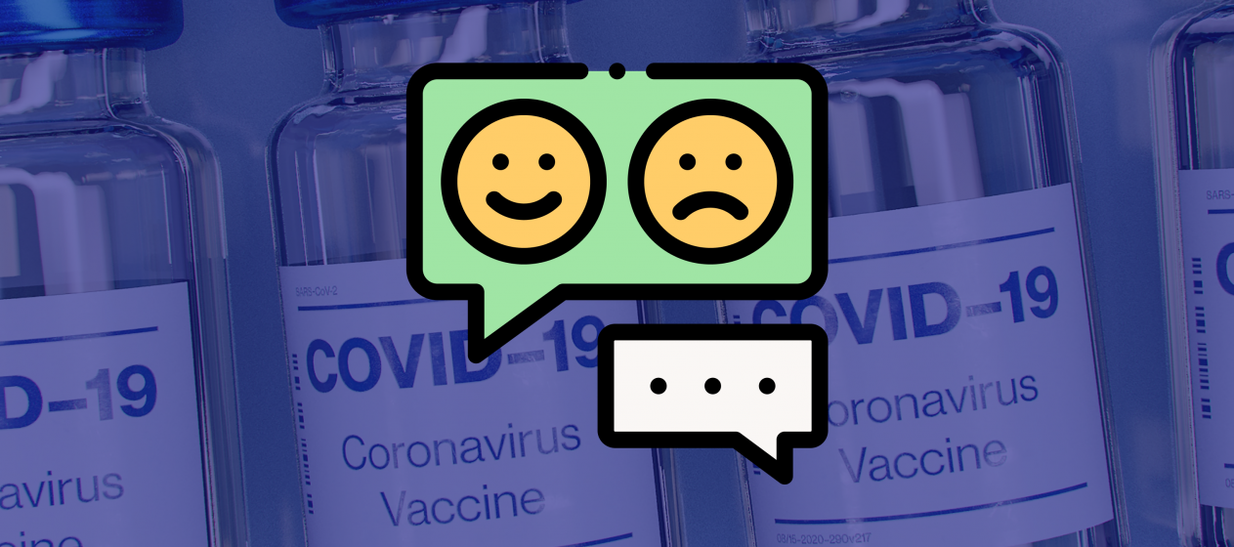
Objective: Use collected Twitter data to analyze and predict the public’s perception of Covid-19 vaccine and provide recommendations to general public and authorities.
Notes:
Despite the importance of understanding the public reaction to COVID-19, gaps in the understanding of COVID-19 related themes still remain. To address this gap, we conducted this analysis of Twitter to examine social media discussions related to COVID-19 and to investigate social sentiments toward COVID-19 vaccination. The objectives are twofold: to provide clarity about online COVID-19 vaccination related topics and predict sentiment regarding COVID-19 vaccination. Findings from this presentation can shed light on unnoticed sentiments and trends related to the COVID-19 vaccine. The results should help guide federal and state agencies, business entities, schools, health care facilities, and individuals as they navigate the pandemic.

Slide 6
02
Tweets Overall Analysis

Slide 7
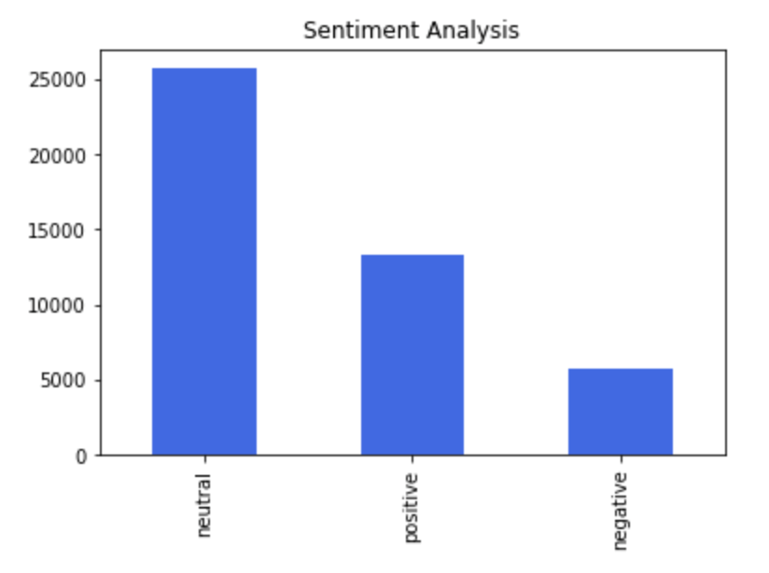
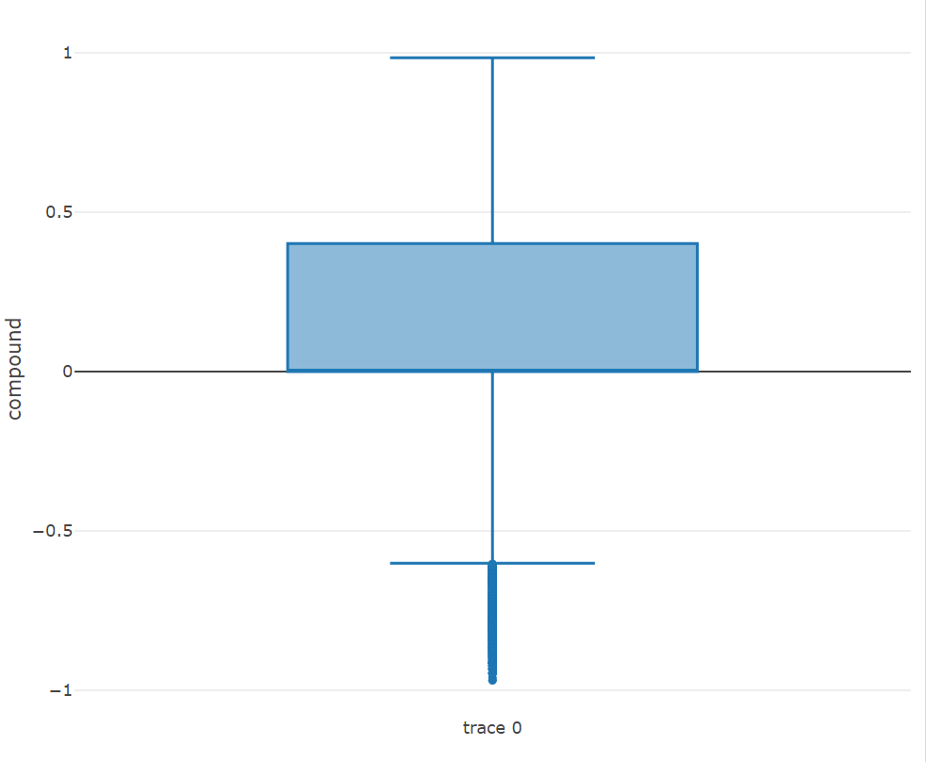
Sentiment Analysis
Positive: Sentiment Score > 0.3
Neutral: Sentiment Score between
0.3 and -0.3
Negative: Sentiment Score < -0.3
Max: 0.9847
q3: 0.4019
Median: 0
The majority of Twitter user’s perception of the COVID vaccine is positive and neutral.
Only a minority of the users (outliers) has extreme negative perception toward vaccinations.
Lower fence: -0.601
Min: -0.9682
Notes:
We first performed sentiment analysis on the tweets’ text. We used VADER library in Python to calculate numerical sentiment score behind each tweet. The sign of the number is the polarity of the sentiment. We want the classification to be more illustrative, so we lift the threshold of abs(intensity) which defines what is a positive tweet and what is negative tweet.
We defined +/-0.3 as the threshold for determining the direction of the polarity. A positive polarity score (>0.3) indicates overall positive sentiment, a negative score (<-0.3) indicates negative sentiment, and between -0.3 and 0.3 means neutral sentiment. The larger the absolute value is, the higher intensity the sentiment will be. The results of the sentiment analysis shows that the majority of Twitter user’s perception of the COVID vaccine is positive and neutral. Only a minority of the users has extreme negative perception toward vaccinations. Such results implies that the public remained hopeful in the face of an unprecedented public health crisis and remain positive attitude toward covid-19 vaccines.

Slide 8
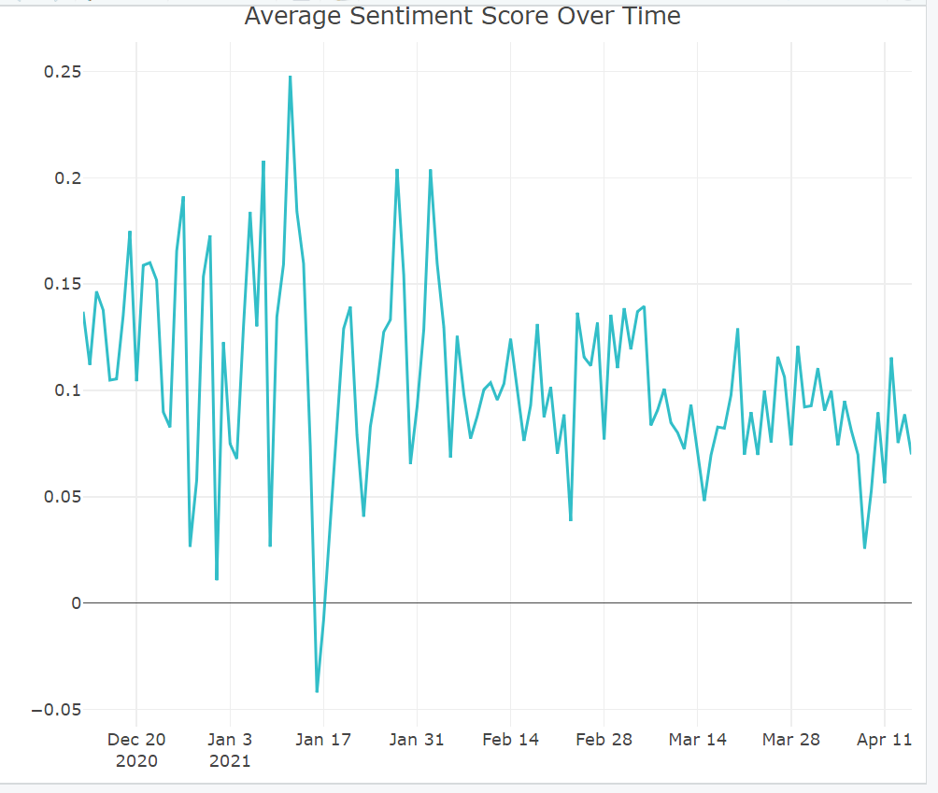
Time Series Analysis
Jan 11
The average sentiment score over time is relatively stable.
Peak: 1/11/2021
Dip: 1/16/2021
Jan 16
Notes:
We conducted a time series analysis on the daily average sentiment score to see how the public react to covid vaccination as time goes by. The daily average sentiment score is relatively stable and it stays within the neutral range. The peak occurs on January 11th, 2021 and the dip occurs on January 16th, 2021. We further examine the news factor that could impact the sentiment change.

Slide 9
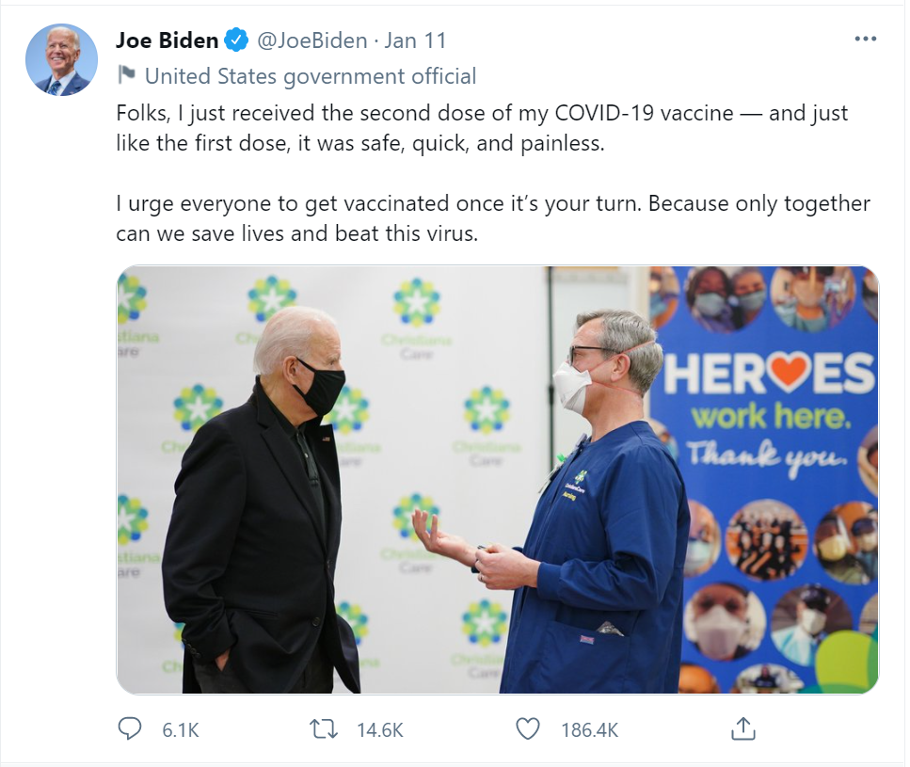
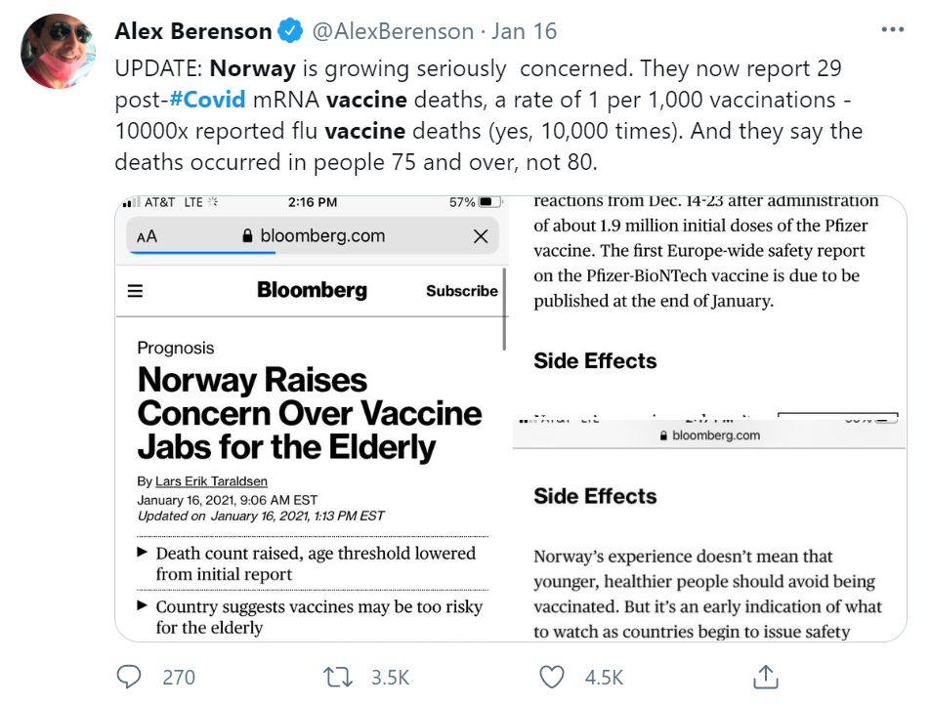


Key Twitter posts influence public’s sentiment score.
Jan 11:
Jan 16:
Notes:
By examining the twitter post on January 11th, Joe Biden tweeted he received both shots of covid 19 vaccine and the shots was safe, quick and painless. This post restored public confidence on the vaccination and encourage more people to receive the shots. Thus, the public sentiment reach its peak on that day. However, on January 16th, Alex Berenson, the former NYT reporter, posted updates on mRNA vaccine that Norway reported 29 death after receiving the vaccine shots. This post possess a ‘red flag’ regard the vaccination. The concerns on the vaccination safety were raised that negatively impact public reactions and their sentiment scores. A portion of the public will potentially change the attitude toward vaccination.
As we can see, tweets posted by twitter influencers could direct impact on public opinion and reactions. It is crucial for the influencer to post positive contents rather than negative contents, because they would never know the potential consequences for those posts.

Slide 10
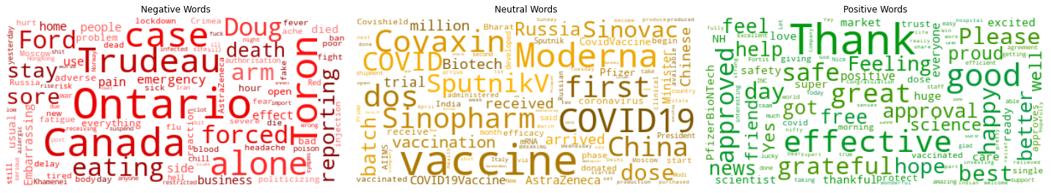
What are People Saying?
Negative Words
Neutral Words
Positive Words
Many complains about Canada
Gratefulness to the vaccinations
Notes:
The above word cloud depicts which words are typically used with respect to each sentiment for tweets mentioning vaccines.
Negative words:
In the word cloud with negatively charged words, there are lots of references to Canadian politician (about Justin Trudeau, Doug Ford extend lockdown) From the original tweets, we noticed that people complained about the distribution/supply of vaccination in canada is slower than EU. We can also see some smaller words mentioning side effects such as arm, pain, headache and even death.
Neutral words:
The neutral words include vaccine provider such as Covaxin, Monderna, Sinopharm, Biotech, SputnikV. The neutral wordcloud seems like containing many neutral discussion of the vaccine and related news.
Positive words:
The positive words consist of many thanks, happiness, and gratefulness toward vaccine approval and frontline workers.
Since the negative toward sentiments toward vaccine may relate to people’s willingness to get vaccinated, we would like to dig deeper into the topics behind negative sentiments.

Slide 11
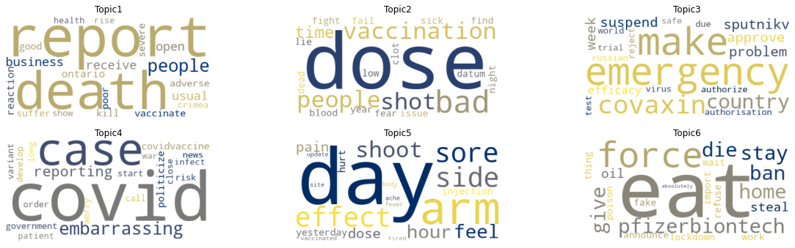
Topic Modeling on Negative Tweets
Notes:
We performed LDA Topic Modeling using MalletLDA by Genism and chose number of topic based on 1) the coherence score 2) the interpretability of the topics. And we found that 6 topics gave us most insights.
Topic 1: combining with original tweets, the word death is refering to death reporting caused by covid instead of vaccine
Topic 2/5 : different level of adverse effect after receiving vaccination
Topic 3: doubt toward Indian made Covaxin and emergency use authorization
Topic 5: dissatisfaction toward climbing covid cases
Topic 6: unsatisfactory toward lockdown and being stuck at home and eat alone. We can see that pfizerbiontech is also in the topic 6, that’s related to the news about 29 death post getting pfizer vaccine.

Slide 12
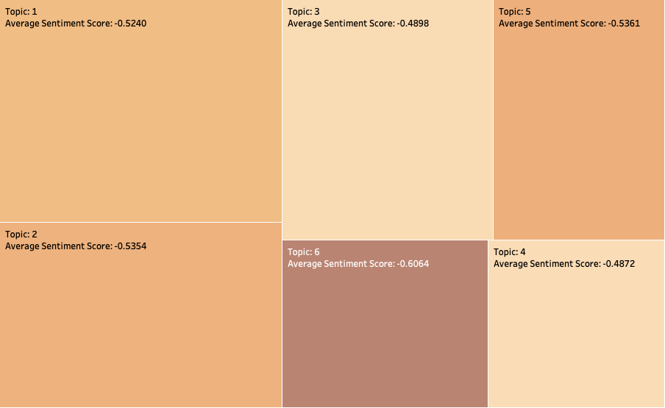
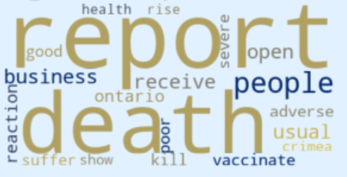
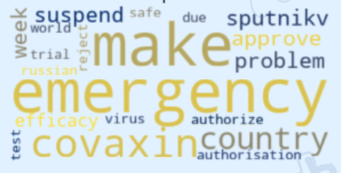
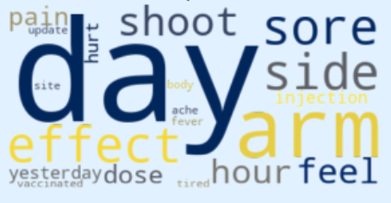
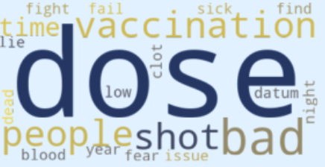
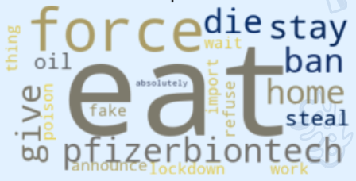
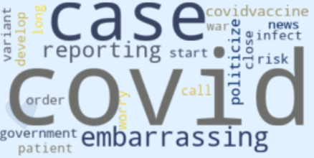
People have stronger sentiment toward lockdown and milder sentiment toward rising cases and vaccine efficacy.
Color by intensity of sentiment
Size by number of comments that fall into the dominant topic
Notes:
We use shade of color to show the intensity of sentiment and size of the boxes to show the number of tweets labeled negative sentiment.
We can see from the treemap that people have highest number of negative tweets negative sentiment toward rising death report due to COVID 19.
The most negative cluster centered around being lockdown and eat alone at home. It seems like people have stronger motion toward extended lockdown and being stuck at home.
The negative sentiment toward emergency use authorization and Indian made generic vaccine is less strong than toward side effects after receive the vaccine.

Slide 13
03
Vaccine Brand Analysis

Slide 14
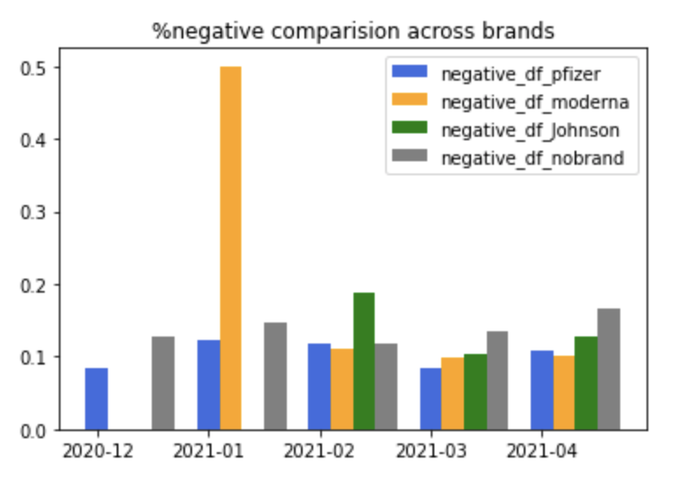
Pfizer has the most stable % Negative sentiments
Moderna
Johnson & Johnson
Moderna’s negative sentiments skyrocketed when it came out and dropped radically to normal in a month.
J & J came out last and has higher %negative sentiments than the other
two brands.
Notes:
We made a side-by-side barplot to diagnose the trend of percentage of negative sentiments for each vaccine brand from Dec. 20 to Apr. 21. We first obtained the sentiment column that contains 3 subcategories: negative, neutral and positive via sentiment analysis. Based on the plot shown above, we found that Pfizer has the most stable percentage of negative sentiments over the 5 months as denoted by the blue bars. Additionally, both Pfizer and J&J did not show a radical decline of % negative sentiment as Moderna did. After all brands were made available to the public, Pfizer shows higher %negative sentiments than the other two brands. No brand means no specific vaccine brand was mentioned in the tweet.

Slide 15
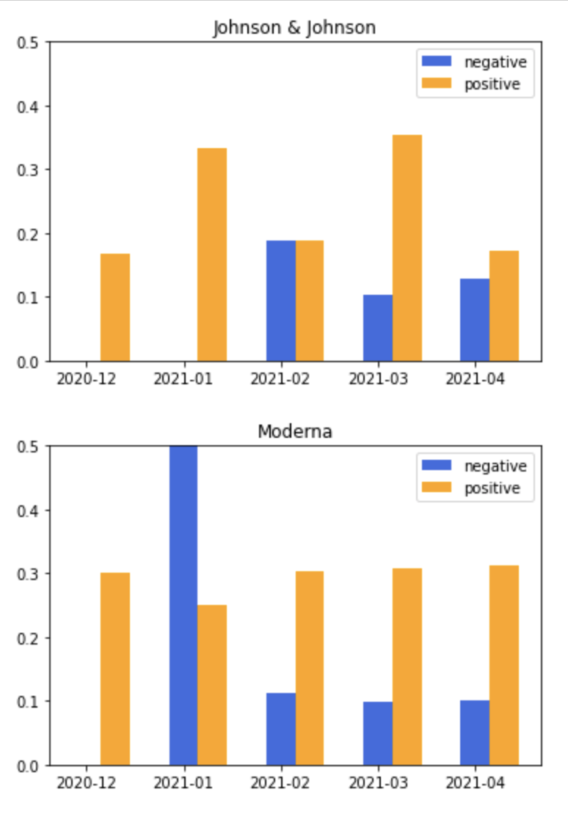
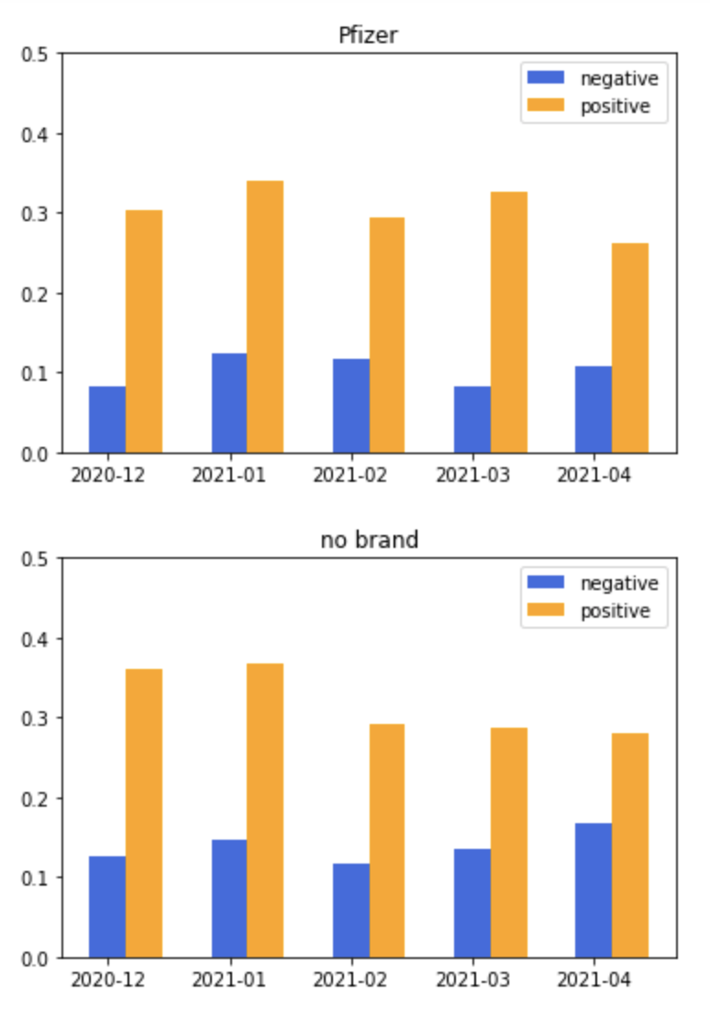
J&J has a greater variance of positive sentiments than the other brands
Notes:
We created the above four bar plots to compare both positive and negative sentiment percentages across vaccine brands from Dec. 20 to Apr. 21. We found that Pfizer and Moderna are very similar in terms of the level of %positive sentiments. Their %positive sentiments did not vary significantly in these 5 months. However, J&J ‘s %positive sentiments showed greater variation during the same period. There are 5 ups and downs altogether over the past 5 months. It indicates that features of J&J’s vaccines were outpaced by Moderna and Pfizer in terms of stability and reliability.

Slide 16
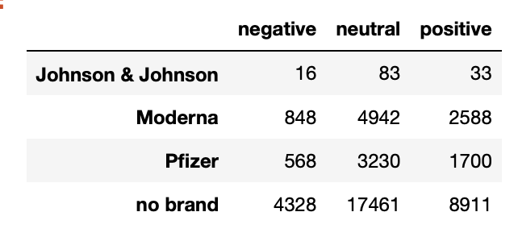
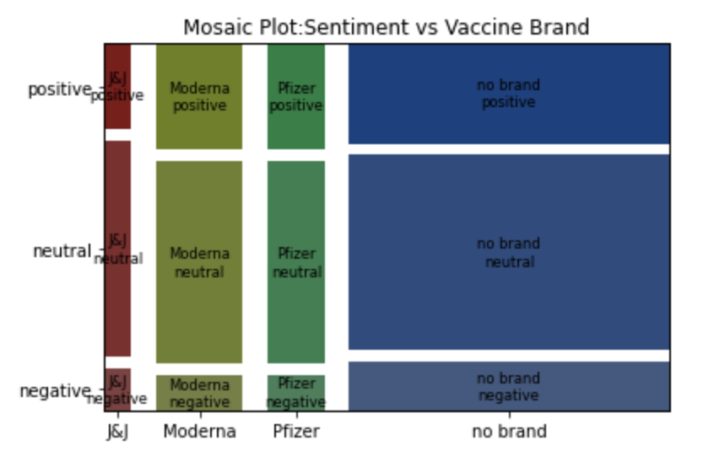
Vaccine Brand is not independent of sentiment categories
Chi-Squared Contingency table
Stat Test
P-value < 0.05, at least
two vaccine brands differ in sentiment distribution
Posterior Analysis: Which one causes difference?
Mosaic Plot
J&J is driving the significant difference across vaccine brands
Notes:
We used Chi-Squared Contingency Table Test to assess the independence between vaccine brand and sentiment categories. We got a p-value < 0.05, which led us to reject the null hypothesis that vaccine brand is independent of sentiment categories. In the posterior analysis, we plotted a Mosaic plot to compare the distribution of sentiment categories for different vaccine brands. Based on the statistical results and the plot, we believe J&J is the brand that causes the significant difference in tweet sentiment among all brands.

Slide 17
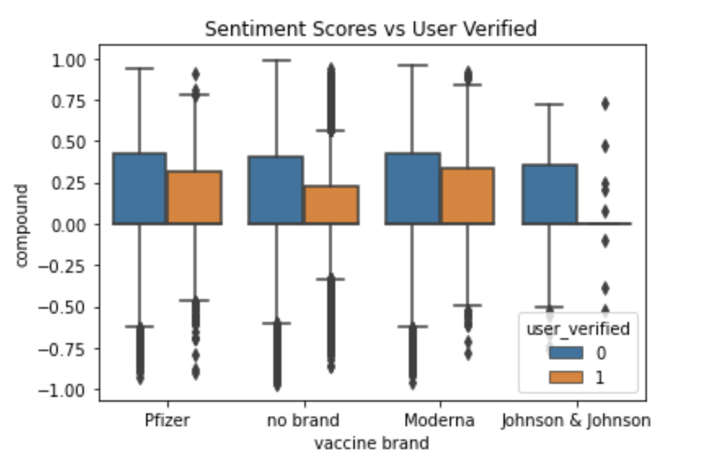
Verified users tend to show less extreme sentiments toward vaccines across brands
J&J
J&J’s verified users has identical or really close sentiment scores
No Brand
When a tweet is not directly
pointing to a vaccine brand,
verified users are cluttered more closely with each other and symmetrically
in terms of extreme sentiments.
Notes:
We plotted a side-by-side boxplot to assess the relationship between sentiment scores(compound) and user verification status. The higher the compound is , the more positive the user’s attitude is toward covid vaccines. We can see that verified users(orange) are generally located more closely on the y axis than unverified users(blue). It implies that verified users tend to avoid showing strong sentiments toward vaccine across all brands. Also, J&J did not show a box in the boxplot for its verified users. It indicates that J&J’s verified users has identical or really close sentiment scores. We also noticed that when a tweet is not directly pointing to a vaccine brand, verified users are cluttered more closely with each other and symmetrically in terms of strong sentiments.

Slide 18
User Tweet Attributes vs Vaccine Brand
 | Average user followers | Average user friends | Average user favorites | Percent user verified
J & J | 7,077 | 1,484 | 12,825 | 0.17
Moderna | 18,369 | 2,083 | 26,489 | 0.06
Pfizer | 37,385 | 1,708 | 16,703 | 0.09
On average, users who made tweets about J&J tend to have fewer tweet followers, friends, and favorites compared to other brands. However, the % verified users for J&J is higher than Moderna and Pfizer.
Notes:
We sliced the dataset into vaccine brand groups and calculated average user behaviors. We found that on average, users who made tweets about J&J tend to have fewer tweet followers, friends, and favorites. The % verified users is higher than Moderna and Pfizer though. This indicates that J&J does not attract as much attention of active and popular users as the other two brands.

Slide 19
04
Sentiment Prediction

Slide 20
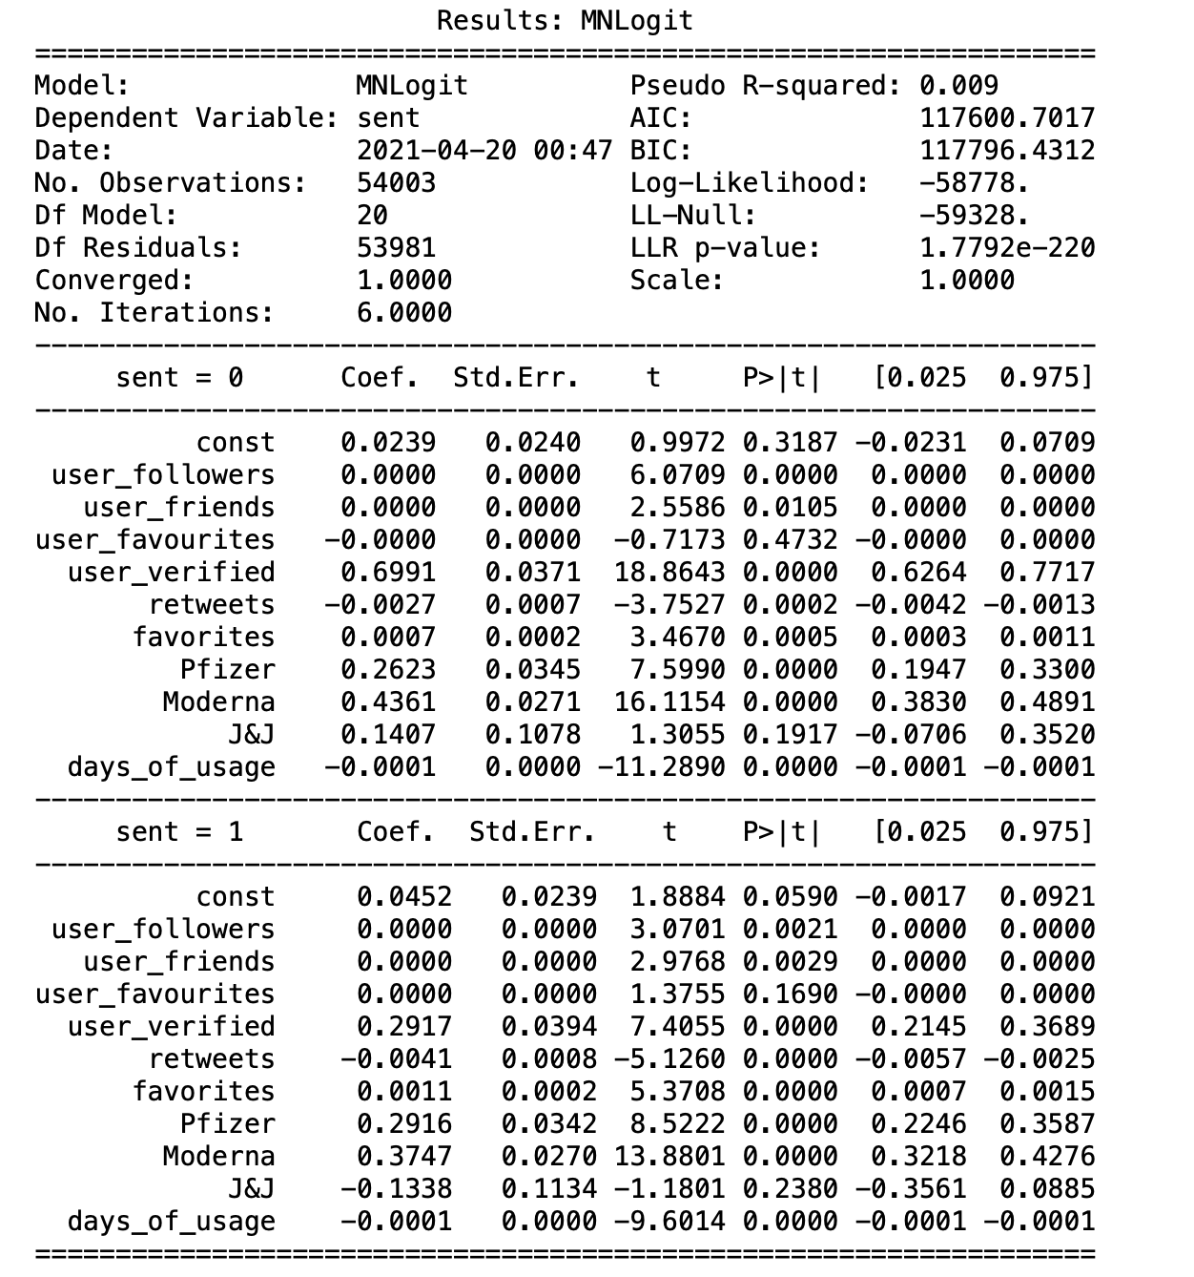
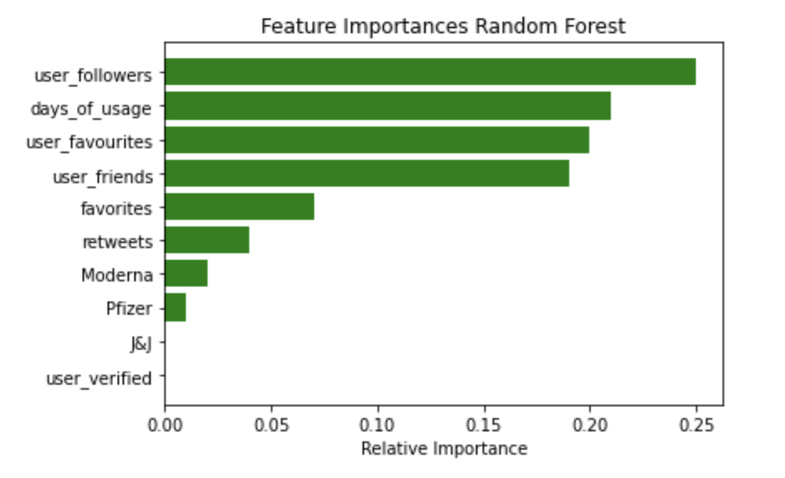
User popularity and experience are positive indicators of tweet sentiments
Notes:
We leveraged Random Forest and Multi-Logistic Regression models to predict user sentiment about COVID vaccines using user behavior data other than the tweet contents. Based on the model results shown above, we found that the more popular the users are, the longer the time they have been using twitter, the more attention they pay to Pfizer or Moderna, the more likely they are to have non-negative sentiment toward COVID vaccines.

Slide 21
05
Recommendations

Slide 22
Recommendations
Refer to verified users’ tweets for objective clarification
Monitor the variation of sentiment for vaccine producers
Educate to ease concerns
Verified users tend to have more credibility and tweet more objectively on general COVID vaccine topics. At the same time, verified users should be more careful with their post contents and perspectives.
Communicate and ease the concerns about side effect to public could encourage public and help facilitate the vaccination to prevent further lockdown.
Research specific reasons behind the variation of sentiment for vaccine producers and monitor its future changes. Understand the core factors that influence the public’s decision making.
Notes:
1.Verified users who tweet about general COVID vaccine topics have closely situated sentiment scores centering the neutral area in the brand analysis. Verified users are more likely to post non-negative tweet as well based on prediction models. So we suggest individuals refer more to tweets of verified users who comment on general COVID vaccine topics for responses with less personal sentiments
2. Since there are a large chunk of negative sentiments are around rising cases and rising death due to COVID, and people did hate lockdown. Facilitating the vaccination process through correcting misunderstanding on the side effect would be a mutual benefit for authority and general public.
3. Research specific reasons behind the variation of sentiment for vaccine producers and monitor its future changes. Understand the core factors that affect people decision making under conditions of uncertainty.

Slide 23

Thanks!
Any Questions?

Slide 24
References
https://www.kaggle.com/gpreda/all-covid19-vaccines-tweets(Dataset)
https://data.cdc.gov/browse?q=COVID-19%20Vaccine%20Distribution%20Allocations%20by%20Jurisdiction%20-%20Janssen&sortBy=relevance
https://www.bloomberg.com/graphics/covid-vaccine-tracker-global-distribution/
https://www.bloombergquint.com/politics/norway-vaccine-fatalities-among-people-75-and-older-rise-to-29
https://www.dw.com/en/covid-19-vaccine-development-whats-the-progress/a-55648707
https://www.census.gov/library/stories/2021/01/around-half-of-unvaccinated-americans-indicate-they-will-definitely-get-covid-19-vaccine.html
https://medium.com/swlh/topic-modeling-lda-mallet-implementation-in-python-part-3-ab03e01b7cd7
https://www.kaggle.com/pawanbhandarkar/generate-smarter-word-clouds-with-log-likelihood#Smarter-Word-Clouds

